Slide 1
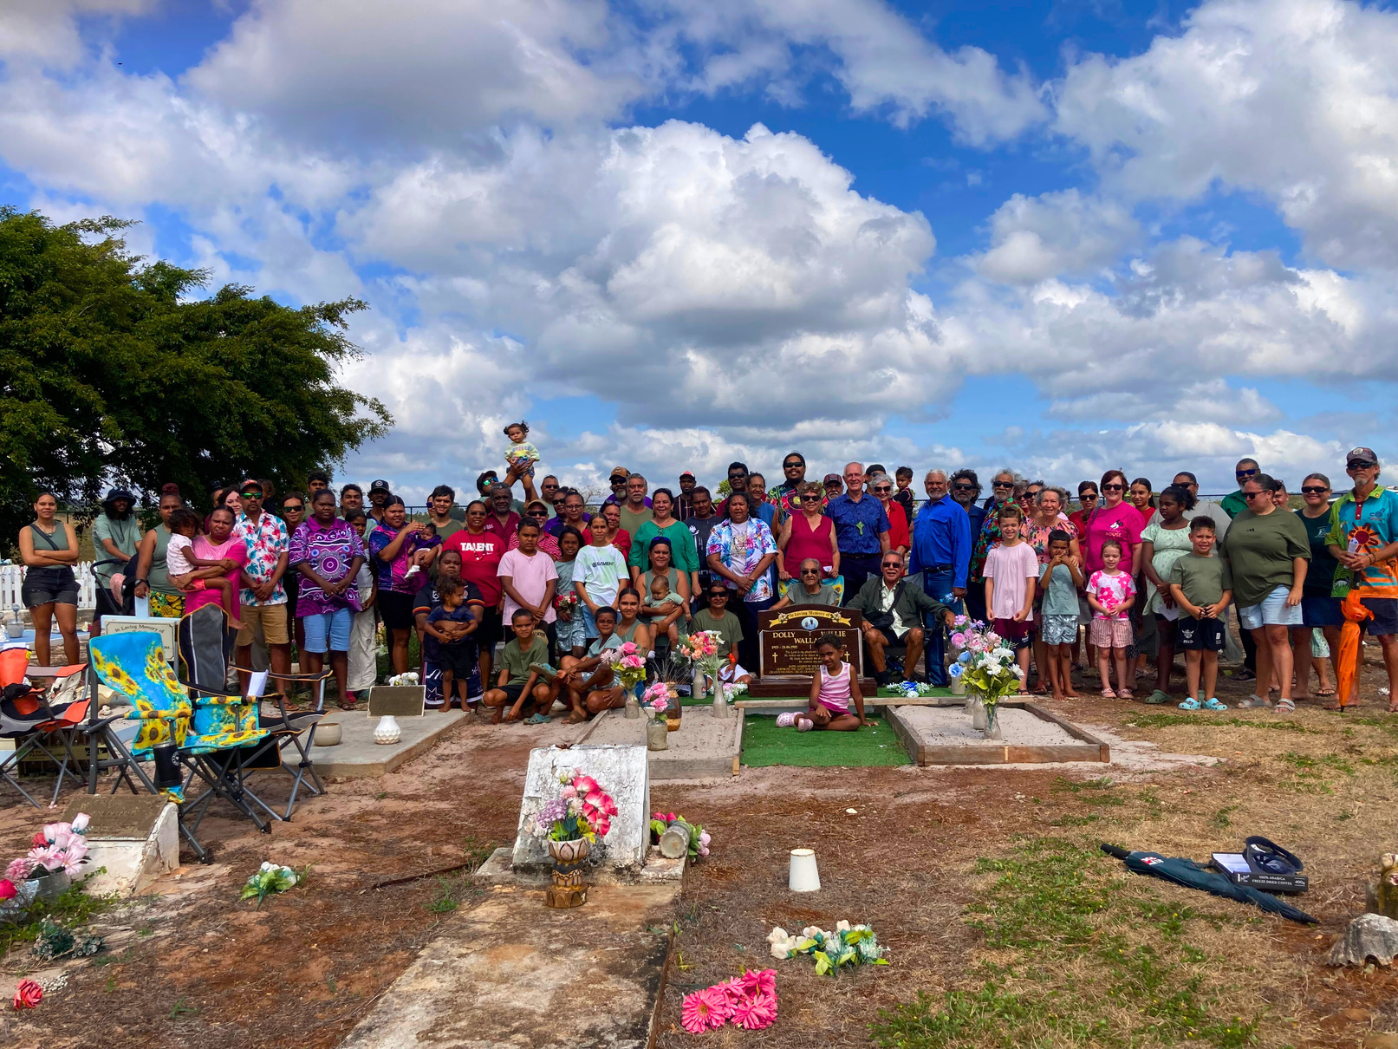








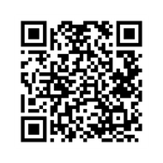





Join the $60 for $60k challenge
We’re raising $60,000 by June 2026 for FNQ Lutheran Ministries. Donate today!
UNITED
FNQ LUTHERAN MINISTRIES

Slide 2
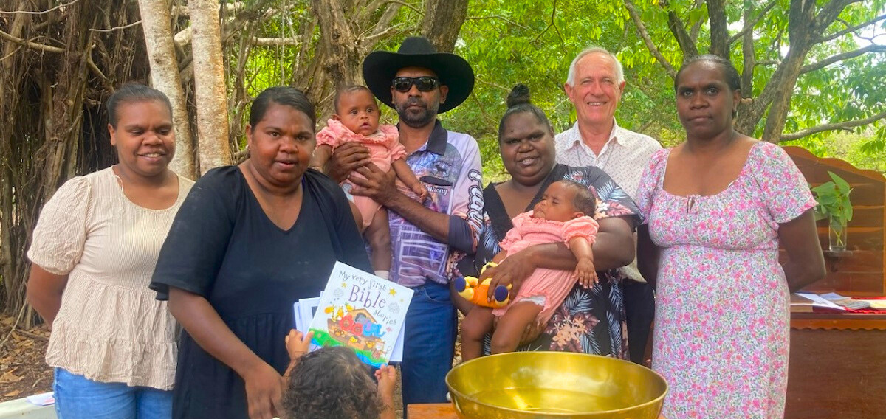
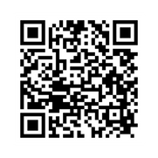

A big thank you to
for raising $ towards our $60k appeal!
Every fundraiser, big or small, makes a difference. Could your group take on the challenge next? Learn how:
UNITED
FNQ LUTHERAN MINISTRIES

Slide 3
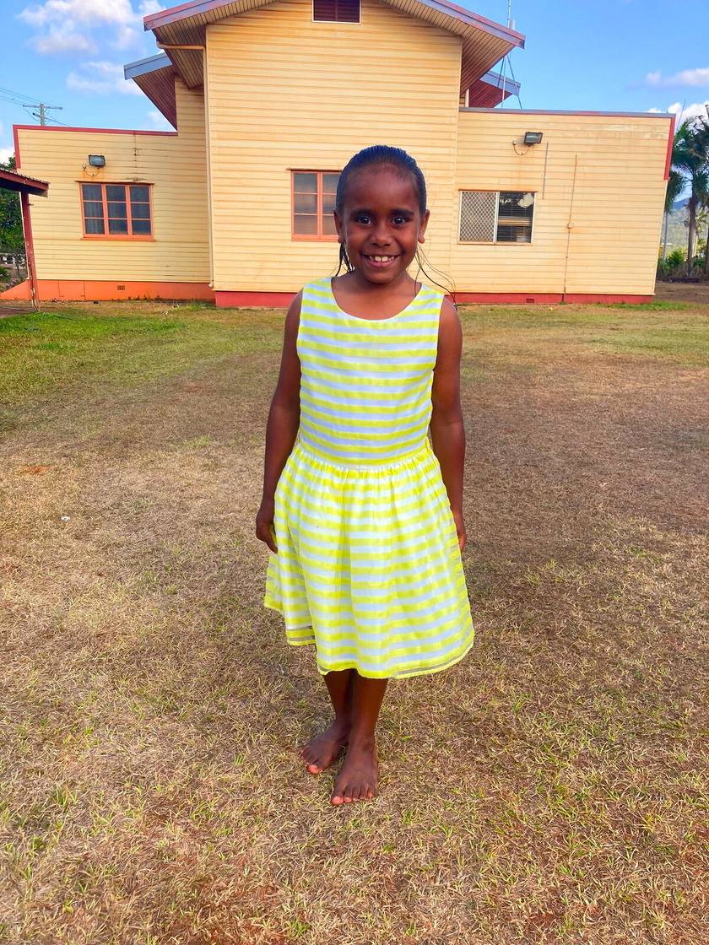
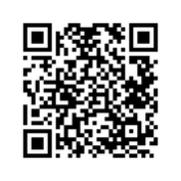
Meet Chloe from Hope Vale. Through your support, ministries in the north are sharing hope, service, and Christ’s love.
Together, we can reach $60k by Synod 2026. Donate here:
UNITED
FNQ LUTHERAN MINISTRIES

Slide 4
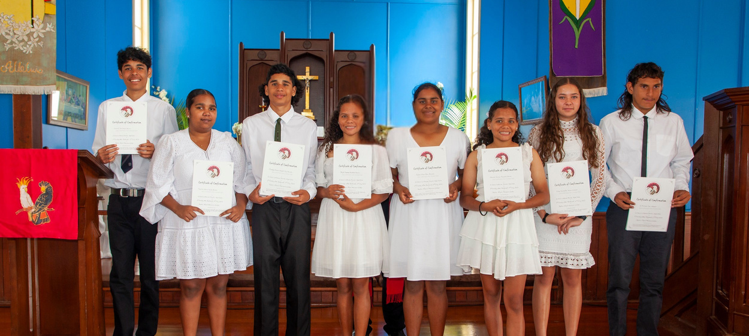
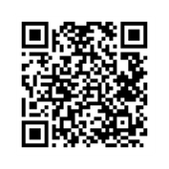

We’re on the way to $60k!
Help us cross the finish line before Synod in June 2026. Every $60 gift gets us closer. Give now:
UNITED
FNQ LUTHERAN MINISTRIES

